Slide 1

Mini project Artificial Neural Networks for Fraud Detection in Supply-Chain-Analytics
Batch No. :- 21PA05 C.Hithen Sai (21P61A0549)
Sai Ram Reddy(21P61A0554)
B.Alekya(21P61A0534)
Project guide: Dr.Swapna mam
(Associate professor)
Dept., of Computer Science and Engineering

Slide 2
CONTENT
ABSTRACT WITH KEYWORDS
INTRODUCTION
LITERATURE SURVEY
PROBLEM STATEMENT
OBJECTIVES
EXISTING SYSTEM & PROPOSED METHODOLOGY
SOFTWARE & HARDWARE REQUIREMENTS
MODULES & IMPLEMENTATION DONE SO FAR
REFERENCES.

Slide 3
ABSTRACT
The integration of Artificial Neural Networks (ANNs) represents a transformative advancement in detecting fraud within supply chain analytics.
This study introduces a novel framework leveraging historical transaction data to identify anomalies associated with fraudulent activities.
It evaluates two machine learning models: an MLPClassifier from scikit-learn and a custom neural network built with Keras. Both models were trained and tested using the DataCo Supply Chain dataset. The findings highlight the superior performance of the ANN-based approach over traditional methods, offering significant improvements in accuracy, speed, and overall effectiveness in fraud detection and supply chain security.
Keywords:MLPClassifier, Transaction Data, Fraud Detection, Artificial Neural Networks (ANN)

Slide 4
INTRODUCTION
.
Neural networks have become crucial in supply chain analytics, helping organizations enhance decision-making and optimize operations. One key application is fraud detection before shipments are processed, which is vital for preventing financial losses.
In this study, we developed two models to address this challenge: one using the MLPClassifier from Scikit-learn and another using a custom neural network built with Keras. Both models leveraged open-source tools such as NumPy, Pandas, Seaborn, Matplotlib, along with machine learning frameworks Scikit-learn, Keras, and TensorFlow.
While the MLPClassifier is recognized for its effective classification capabilities, the custom Keras model offers greater control over the architecture and training process, aiming to detect fraudulent activities early and reduce financial risks.

Slide 5
LITERATURE SURVEY
S.No | Author | Title | Dataset | Methodology | pro | conclusion | limitation | Future Directions
1 | Bolton, R. J., & Hand, D. J. (2002) | Statistical Fraud Detection: A Review | Various financial datasets from different industries | Statistical models (decision trees, linear regression) | Simple to implement, well-established techniques | Effective in detecting traditional, simple fraud patterns | -Unable to capture sophisticated fraud schemes -Limited ability to handle complex patterns, struggles with non-linear data | Incorporation of advanced machine learning models like ANNs to improve detection accuracy
2 | Rifkin, J. & Klautau, A. (2004) | Synthetic datasets for fraud detection | Credit card fraud dataset (delayed supervised data) | Naive Bayes, K-nearest neighbors (KNN) | Simple, easy to interpret models | Poor performance with high-dimensional data | Traditional algorithms are limited in their ability to handle complex fraud patterns - | Focus on improving real-time fraud detection using neural networks

Slide 6
3 | Kou, Y., et al. (2004) | Survey of Fraud Detection Technique | Survey of datasets from telecommunications, banking, and insurance sectors | Data mining and machine learning techniques | Wide range of applications, flexible techniques | Machine learning models like neural networks outperform rule-based systems | -High complexity, difficult to interpret model outputs. -Difficulty in scaling models to large, real-world datasets | Explore hybrid models that combine neural networks with traditional techniques
4 | Phua, C., et al. (2010) | A Comprehensive Survey of Data Mining-Based Fraud Detection Research | Multiple datasets across different industries (telecom, banking) | Data mining and machine learning-based model | Broad overview of techniques, adaptable to many industries | Neural networks demonstrate high potential for fraud detection | -May not generalize well across all types of fraud. -Generalization to all fraud types remains a challenge | Focus on improving generalization using deep learning models
5 | Ngai, E. W., et al. (2011) | Data Mining Techniques in Financial Fraud Detection | Financial data from multiple industries | Data mining and classification models | Effective for certain types of fraud (e.g., financial fraud) | Data mining techniques have a strong track record for detecting specific frauds | -Real-time detection is a major challenge -Lack of real-time application limits the impact | Develop models capable of handling real-time fraud detection in dynamic environments

Slide 7
6 | Dal Pozzolo, A., et al. (2018) | Credit Card Fraud Detection and Concept-Drift Adaptation | Neural networks with delayed supervised information | Addresses concept drift in dynamic environments | Neural networks improve accuracy over time | Requires large labelled datasets -Difficult to implement in real-time systems due to processing delays | Explore advanced algorithms for better performance

Slide 8
PROBLEM STATEMENT
Increasing Complexity in Fraud Detection Traditional fraud detection systems struggle to handle the increasing complexity and scale of modern supply chains, leading to inefficiencies and potential financial losses.
Inadequate Fraud Prevention Mechanisms
Need for Enhanced Accuracy in Fraud Detection
Existing methods fail to identify intricate patterns of fraudulent activities in supply chain data, necessitating more advanced approaches for effective detection.Supply chain organizations require more accurate and scalable solutions, such as neural networks, to proactively identify fraud and reduce operational risks.

Slide 9
OBJECTIVES
To detect fraudulent activities in the supply chain by developing machine learning models using neural networks. The goal is to enhance fraud detection accuracy, minimize financial losses, and improve operational efficiency for organizations by utilizing the MLPClassifier algorithm from scikit-learn and a custom neural network built with Keras. These models are trained on the DataCo Supply Chain dataset to identify fraudulent transactions.

Slide 10
EXISTING SYSTEM
Utilizes rule-based systems and statistical models for fraud detection.
Relies on manually set thresholds or predefined rules for identifying suspicious transactions.
Limited scalability, struggling to manage large datasets typical in global supply chains.
Unable to detect complex, evolving fraud patterns and adaptive fraudsters.
Lacks the ability to learn from new data or adapt to emerging fraud schemes.

Slide 11
PROPOSED METHODOLOGY
Implements Artificial Neural Networks (ANNs) for fraud detection, offering a data-driven approach.
Develops two models: MLPClassifier from scikit-learn and a custom neural network built with Keras.
Capable of learning from historical and real-time data, improving adaptability to fraud patterns.
Highly scalable, designed to handle large and complex datasets within global supply chains.
Provides higher accuracy in detecting fraudulent transactions (97.67% for the custom model), reducing manual intervention and financial losses.

Slide 12
MODULES
Data Collection and Preprocessing: Utilize the DataCo Supply Chain dataset, handle missing data, outliers, and normalize features to prepare the data for model input.
Model Development: Create two fraud detection models: one using MLPClassifier from scikit-learn, and a custom neural network using the Keras library in Python.
Model Training and Testing: Split the dataset into training and testing sets, train both models, and evaluate their ability to detect fraudulent activities.
Performance Evaluation: Assess both models' performance based on accuracy, precision, recall, and F1-score, with the custom neural network achieving 97.67% accuracy.
Result Analysis and Optimization: Refine models by adjusting hyperparameters and improving their architectures to further enhance fraud detection efficiency.

Slide 13
IMPLEMENTATION DONE SO FAR
Data Collection and Pre-processing: I collected a dataset containing features like transaction ID, amount, timestamp, customer ID, and product category. Pre-processing involved handling missing values through imputation, normalizing features using Min-Max scaling, and encoding categorical variables.
Current Work: I am currently developing the ANN algorithm, focusing on defining the model architecture and preparing for training on the pre-processed dataset.

Slide 14
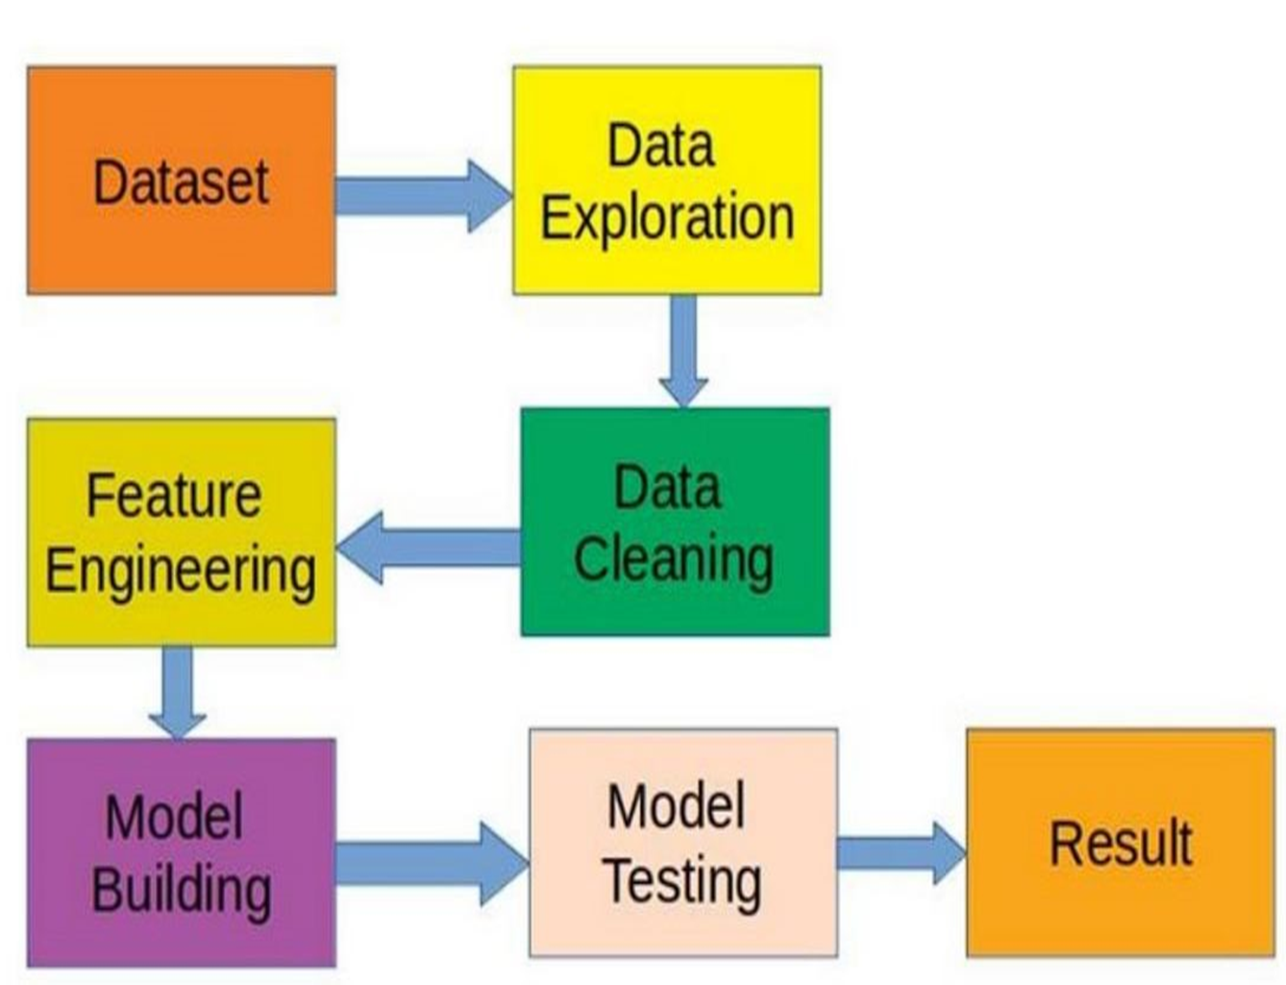

Slide 15
SYSTEM REQUIREMENTS
- Hardware Requirements:
Processor: Multi-core processor (e.g., Intel i5 or higher).
RAM: 8 GB or higher for smooth data processing.
Storage: 100 GB of free space to store datasets and project files.
GPU (optional): If using TensorFlow for neural networks, a dedicated GPU with CUDA support will speed up model training.
Operating System: Windows 10, macOS, or Linux.
- Software Requirements:
Python 3.6+: Minimum version for compatibility with modern libraries like Keras, scikit-learn, and TensorFlow.
Keras: For building and training neural networks.scikit-learn: For implementing the MLPClassifier and other machine learning models.
Pandas and NumPy: For data manipulation and numerical computations.Jupyter Notebook: For writing, running, and documenting the code.

Slide 16
References
Bolton, R. J., & Hand, D. J. (2002) - "Statistical Fraud Detection" - Used logistic regression and decision trees.
Dal Pozzuoli, A., et al. (2018) - "Credit Card Fraud Detection" - Applied random forests and decision tree
Kou, Y., et al. (2004) -Rule-based and clustering techniques for fraud detection”- Rule-based systems, clustering.
Phua, C., et al. (2010)- A comprehensive survey of fraud detection techniques”-Support vector machines (SVM), logistic regression.
Ngai, E. W., et al. (2011)-Data Mining Techniques in Financial Fraud Detection-Data mining and classification models.
Rifkin, J. & Klautau, A. (2004)-Naive Bayes, K-nearest neighbors (KNN)-Synthetic datasets for fraud detection

Slide 17


